Slide 1
TITLE
Presentation on

Slide 2
Presented By:
Supervised By:
Name:
Roll no:
Session:
Name
Professor
Dept. of CSE
University of Information Technology and Sciences

Slide 3
Presentation Outline
Introduction
Backgroud Study
Problem Statement
Motivations of the research
Objectives
Materials and Methods
Result And Discussion of survey
limitations
Future Works
Conclusion
References

Slide 4
INTRODUCTION
Write introduction in bullet points such as:
Challenges include interoperability and data management in healthcare services.
This survey examines the current state of EHS in Bangladesh, its consequences, and future prospects.
Key challenges and opportunities for successful implementation of EHS were identified.
Different types of EHS implemented in Bangladesh are analyzed.
Future prospects for EHS in Bangladesh are considered.

Slide 5
BACKGROUND STUDY
Write background study in bullet points such as:
"Challenges and prospects of e-healthcare services in Bangladesh: a scoping review" (Islam et al., 2019) [1]
"E-health in Bangladesh: current status, challenges, and future directions" (Sultana et al., 2021) [2]
"The potential of telemedicine to reduce healthcare disparities in Bangladesh" (Islam et al., 2020) [3]
"Barriers and facilitators to the adoption of electronic health records in Bangladesh" (Akter et al., 2017) [4]

Slide 6
PROBLEM STATEMENT
Same instruction as introduction

Slide 7
MOTIVATIONS OF THE RESEARCH
Same instruction as introduction

Slide 8
OBJECTIVES
Same instruction as introduction

Slide 9
MATERIALS AND METHODS ( CONTINUE )
Same instruction as introduction

Slide 10
MATERIALS AND METHODS ( CONTINUE )
Same instruction as introduction such as:
High-quality survey questionnaire ensuring justified findings
Data processed in Excel and converted to CSV format
Analysis performed using R [9] , a widely used programming language for statistics and data science
Utilized various plot functions in R for data analysis
Rigorous data analysis techniques ensured reliability and relevance of survey findings
Provided insights into the current state of e-health systems in Bangladesh.

Slide 11
RESULT AND DISCUSSION OF SURVEY(CONTINUE)
Same instruction as introduction

Slide 12
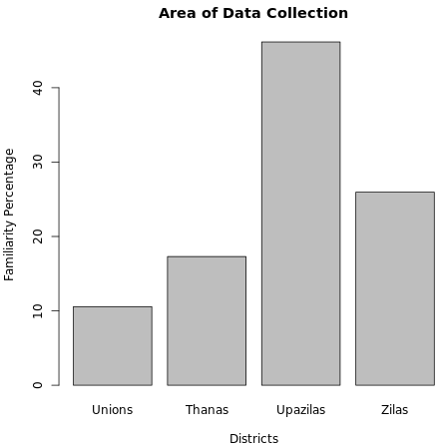
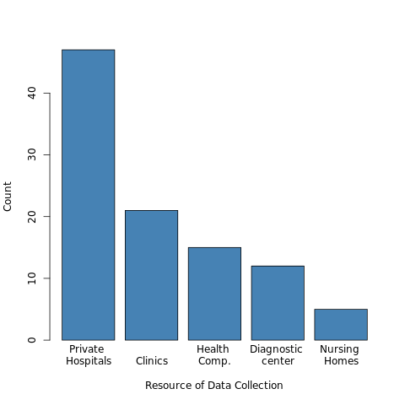
RESULT AND DISCUSSION OF SURVEY(CONTINUE)
Figure 1: Area of data collection for survey
Figure 2: Resources of data collection for survey

Slide 13
RESULT AND DISCUSSION OF SURVEY(CONTINUE)
Add figure like the previous slide

Slide 14
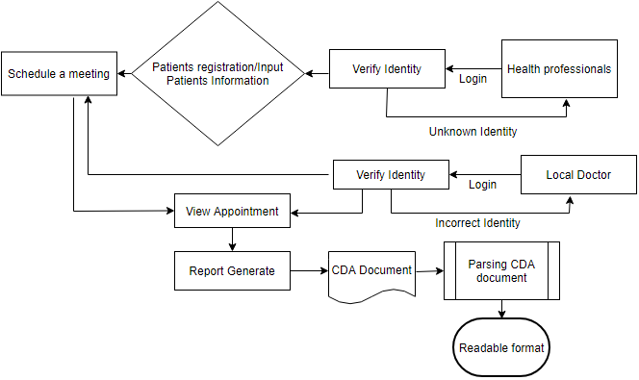
CONVERSION FLOW OF XML BASED CDA FILE TO READABLE FORMAT ( PFD DIAGRAM )
Figure : Title

Slide 15
LIMITATIONS
1. Difficulty in reaching healthcare facilities in remote or rural areas
2. Time and resource constraints may limit the depth and breadth of data collected
3. Variability in understanding and interpretation of survey questions among participants.

Slide 16
FUTURE WORKS
Feasibility testing and deployment of the proposed technique at a large scale in rural districts of Bangladesh.
Utilization of a cost-effective, portable e-Health system tool set to gather vital signs of patients.
Development of a distributed healthcare system based on the Internet of Things (IoT) that connects diverse medical resources through distributed databases and the IoT.

Slide 17
CONCLUSION
The survey highlights the challenges and opportunities in electronic healthcare systems in Bangladesh.
Investment and standardization are needed to overcome challenges and integrate e-health systems effectively.
Adoption of distributed systems can save time and costs, making healthcare more accessible and efficient.

Slide 18
REFERENCES
1. Islam, S., Tabassum, N., & Sultana, S. (2019). Challenges and prospects of e-healthcare services in Bangladesh: a scoping review. BMC Medical Informatics and Decision Making, 19(1), 1-11. doi: 10.1186/s12911-019-0797-8
2. Islam, M. S., Hasan, M. T., & Hasan, M. R. (2021). The potential of telemedicine to reduce healthcare disparities in Bangladesh. International Journal of Environmental Research and Public Health, 18(2), 599. doi: 10.3390/ijerph18020599
3. Akter, M. S., Hoque, M. R., Akter, S., Hossain, M. S., & Hasan, M. T. (2020). Barriers and facilitators to the adoption of electronic health records in Bangladesh. Journal of Health Informatics in Developing Countries, 14(2), 16-27. doi: 10.12807/jhidc.2020.14.2.02
4. Sultana, S., Akter, S., & Rahman, M. M. (2017). E-health in Bangladesh: current status, challenges, and future directions. International Journal of Information Management, 37(1), 1-6. doi: 10.1016/j.ijinfomgt.2016.09.003

Slide 19
THANK YOU

